Slide 1
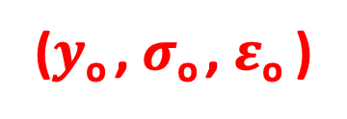
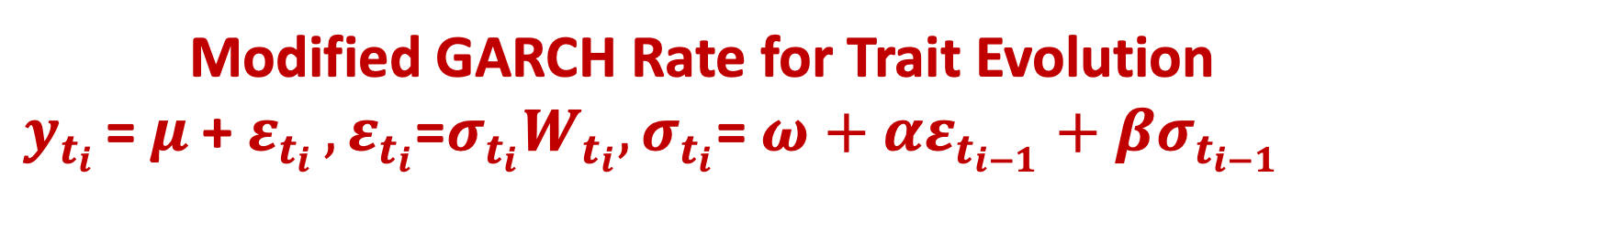
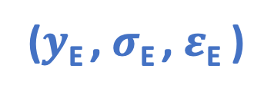
Modified GARCH Rate for Trait Evolution
$y_{t_{i}}$ = $μ$+ $ε_{t_{i}}$ $,ε_{t_{i}}\text{=}σ_{t_{i}}W_{t_{i}},σ_{t_{i}}$= $ω+αε_{t_{i−1}}+βσ_{t_{i−1}}$
A B C
($y$_{A} , $σ$_{A} , $ε$_{A} ) ($y$_{B} , $σ$_{B} , $ε$_{B} ) ($y$_{C} , $σ$_{C} , $ε$_{C} )
t₂
E
($y$_{E} , $σ$_{E} , $ε$_{E} )
Time
t₁
O
($y$_{o} , $σ$_{o} , $ε$_{o} )
Trait values

