Slide 1
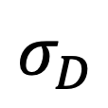
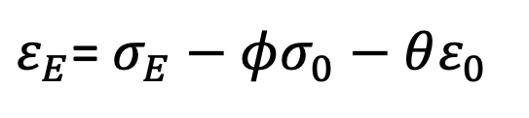
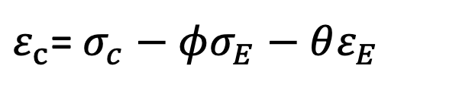
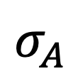
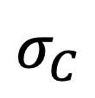

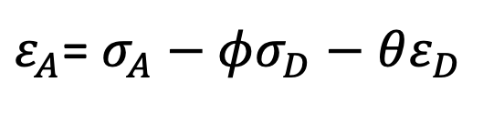
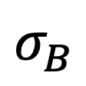
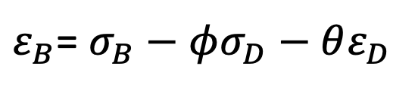

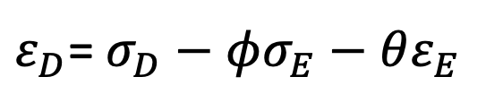
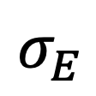
ARMA(1,1) Rate: $ε_{des}$ = $σ_{des}−φσ_{anc}−θε_{anc}$
$ε_{A}$= $σ_{A}−φσ_{D}−θε_{D}$
A
$$σ_{A}$$
$ε_{D}$= $σ_{D}−φσ_{E}−θε_{E}$
$$σ_{D}$$
D
$ε_{B}$= $σ_{B}−φσ_{D}−θε_{D}$
B
$$σ_{B}$$
O
E
$$σ_{E}$$
$ε_{E}$= $σ_{E}−φσ_{0}−θε_{0}$
$$(σ_{0},ε_{0})$$
$ε_{c}$= $σ_{c}−φσ_{E}−θε_{E}$
C
$$σ_{C}$$

