Slide 1
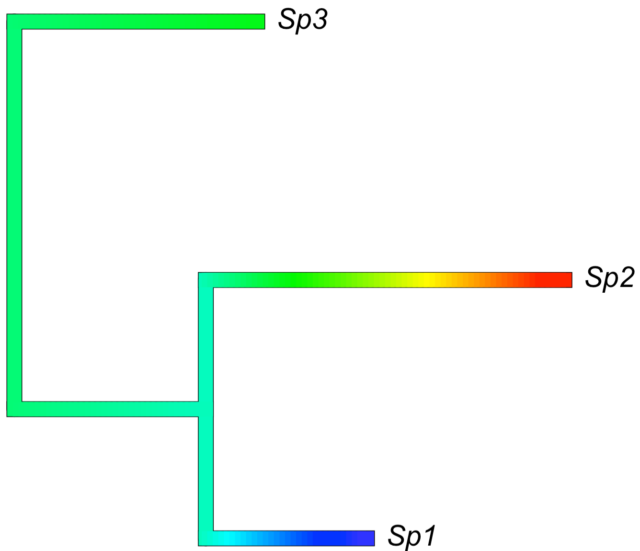

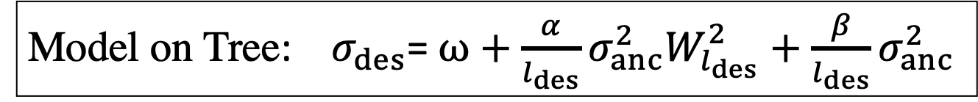








Model on Tree: $σ_{des}$= $ω+\frac{α}{l_{des}}σ_{anc}^{2}W_{l_{des}}^{2}+\frac{β}{l_{des}}σ_{anc}^{2}$
$σ_{3}^{2}$= $ω+\frac{α}{l_{3}}σ_{5}^{2}W_{l_{4}}^{2}+\frac{β}{l_{3}}σ_{5}^{2}$
C
$$l_{3},σ_{3}$$
Root
$$σ_{5}$$
$σ_{2}^{2}$= $ω+\frac{α}{l_{2}}σ_{4}^{2}W_{l_{2}}^{2}+\frac{β}{l_{2}}σ_{4}^{2}$
B
$$l_{2},σ_{2}$$
$$l_{4},σ_{4}$$
$σ_{4}^{2}$= $ω+\frac{α}{l_{4}}σ_{5}^{2}W_{l_{4}}^{2}+\frac{β}{l_{1}}σ_{5}^{2}$
$σ_{1}^{2}$= $ω+\frac{α}{l_{1}}σ_{4}^{2}W_{l_{1}}^{2}+\frac{β}{l_{1}}σ_{4}^{2}$
A
$$l_{1},σ_{1}$$

